Slide 1
A Music Sharing App
Hot Pot
Team 26

Slide 2
What is Hot Pot?
Multiple Users
Share Music Together
Real-time

Slide 3
Our Schedule
Spotify API:
Build a functional prototype
Second Sprint
last
UI/UX:
Core static pages

Slide 4
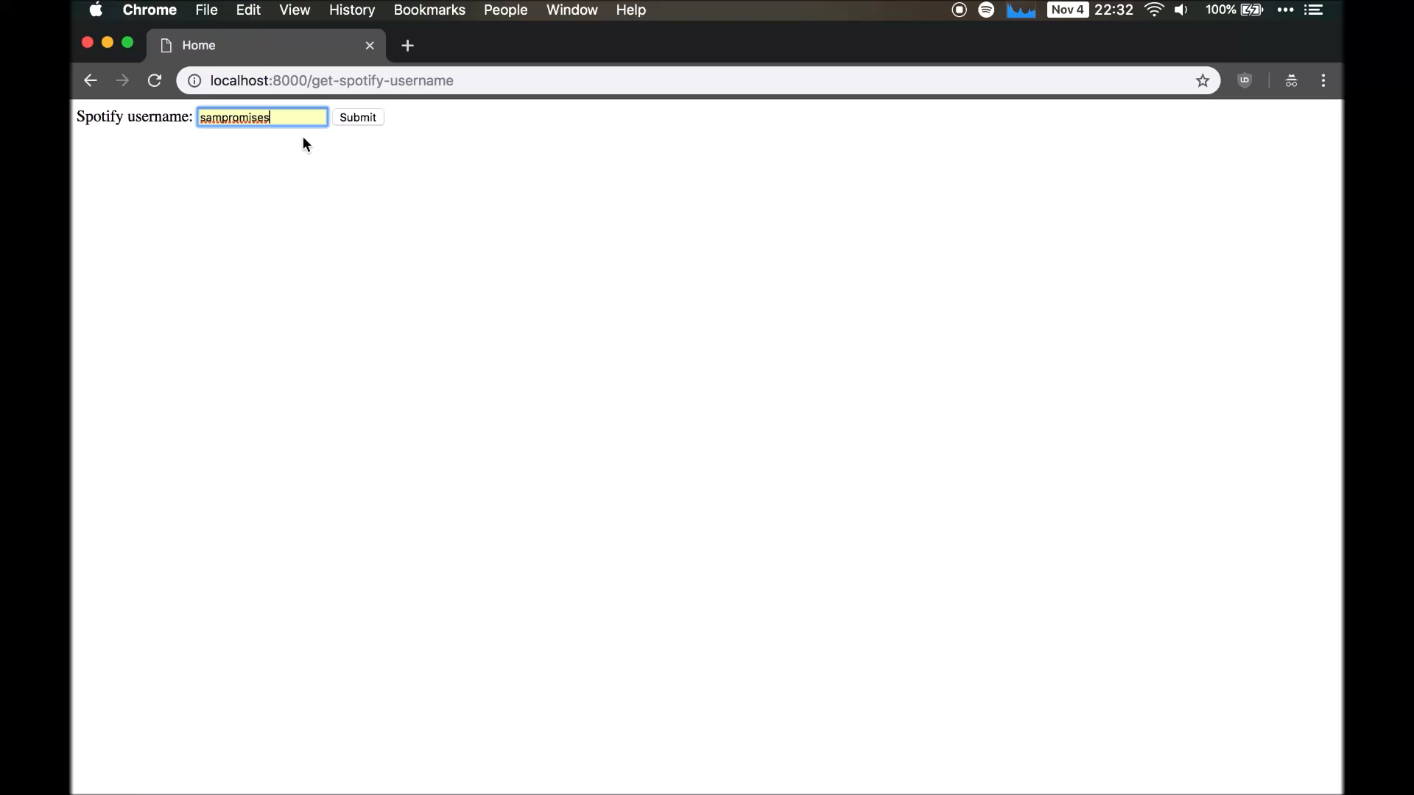

Slide 5
We aimed for
Spotify API Back End
Front End Pages
Django Login
User/Room Setting
Search songs in Spotify
Play Spotify Music on Web app
Home
Create a Room
Create a DJ room with empty Playlist
Add the song to Playlist
Login
Room
Spotify Account Authentication
Fetch and show search results
Explore
Register

Slide 6

We accomplished
Django Login
User/Room Setting
Back End
Front End
Search songs in Spotify
Play Spotify Music on Web app
Home
Create a Room
Create a DJ room with empty Playlist
Add the song to Playlist
Login
Room
Spotify Account Authentication
Fetch and show search results
Explore
Register

Slide 7
Problems & Progress
Problems
- Synchronizing playback across multiple listeners
- Cannot play the song we want to
Proposed solutions
Sending song_id + offset to each listener so the client can start playback at the right time
Possibly pivot to using YouTube API, which has better support

Slide 8
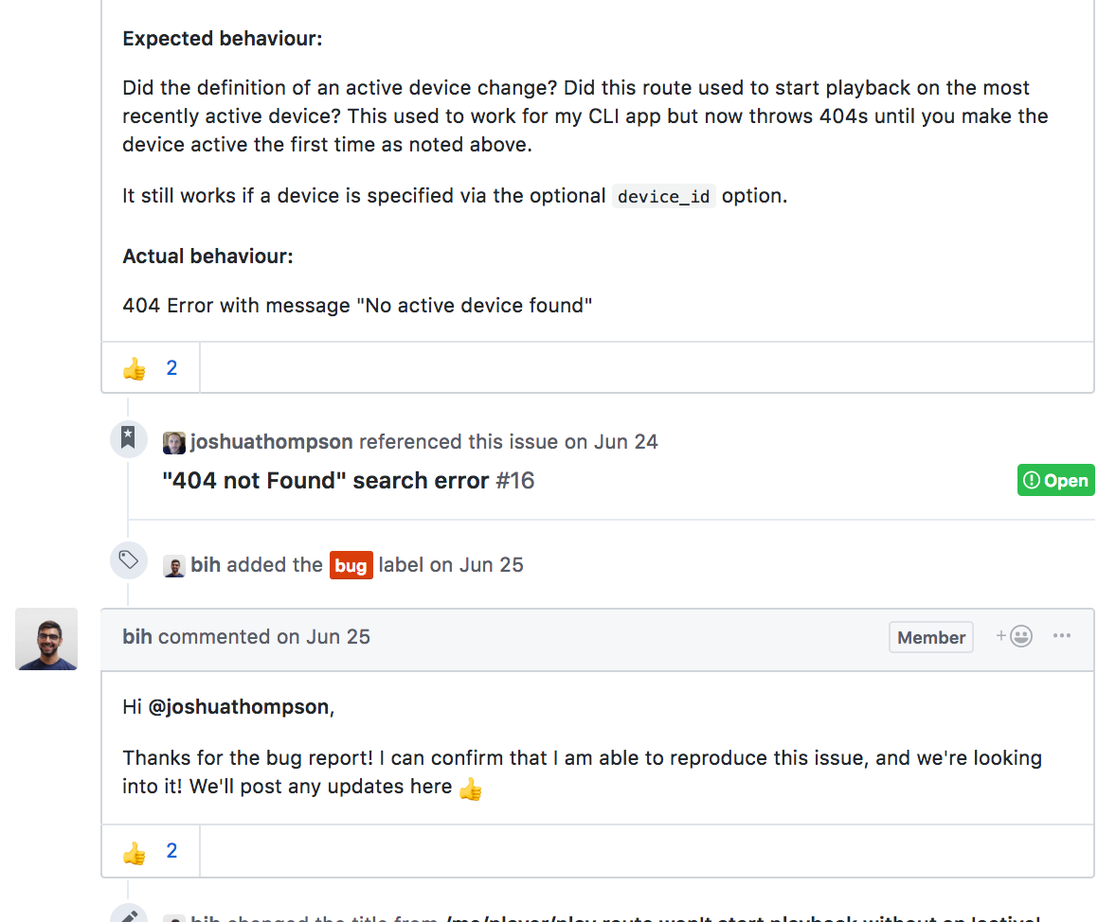
Problems & Progress
Problem
Some parts of Spotify API are in beta and not fully functional...
Proposed solution
Unfortunately, so far we could not find a perfect way to solve this problem. For the next week, we are going to do more research.
A back up plan is Youtube API, which has better support and easier authentification
Notes:
Spotipy (the Python wrapper we relied on) does not refresh tokens automatically
Web Playback SDK is in ‘Beta’ and not fully functional. Also a crucial endpoint in the Spotify Web API seems to have an unresolved bug (opened this past June on GitHub).

Slide 9
Problems & Progress
Problem
Some parts of Spotify API are in beta and not fully functional...
Proposed solution
Unfortunately, so far we could not find a perfect way to solve this problem. For the next week, we are going to do more research.
A back up plan is Youtube API, which has better support and easier authentification
Notes:
Spotipy (the Python wrapper we relied on) does not refresh tokens automatically
Web Playback SDK is in ‘Beta’ and not fully functional. Also a crucial endpoint in the Spotify Web API seems to have an unresolved bug (opened this past June on GitHub).

Slide 10
Our Schedule
Spotify API:
Build a functional prototype
Second Sprint
last
UI/UX:
Core static pages

Slide 11
Moving on to Next Week

Slide 12
Primary Goal:
Integration of separate parts
Add People to Room
Search Room by DJ or by Room No.
User/Room Setting
Display Lyrics / Album cover
Django Login
Explore Nearby
More Animation
Add/Block People to Room
Vote for the Playlist
Play the Playlist in order

Slide 13
Summary: we are Team 26, Our project: Hot Pot is a Music Sharing App, which supports:
Create a room and invite people
Share Spotify Playlist in real time
Connect businesses with Hot Pot rooms so customers can vote for what songs are played

Slide 14

Thanks!
Any questions?

